Slide 1

SANA
.
THE CHATBOT WITH VOICE ASSISTANT
BY TEAM WIZARDS

Slide 2
AGENDA
PROBLEM STATEMENT
TOOLS USED
CODE EXPLANATION
WORKING OF THE CHATBOT
FEATURES
PROS AND CONS
CONCLUSION

Slide 3
AGENDA
PROBLEM STATEMENT
TOOLS USED
CODE EXPLANATION
WORKING OF THE CHATBOT
FEATURES
PROS AND CONS
CONCLUSION

Slide 4
AGENDA
PROBLEM STATEMENT
TOOLS USED
CODE EXPLANATION
WORKING OF THE CHATBOT
FEATURES
PROS AND CONS
CONCLUSION

Slide 5
AGENDA
PROBLEM STATEMENT
TOOLS USED
CODE EXPLANATION
WORKING OF THE CHATBOT
FEATURES
PROS AND CONS
CONCLUSION

Slide 6
AGENDA
PROBLEM STATEMENT
TOOLS USED
CODE EXPLANATION
WORKING OF THE CHATBOT
FEATURES
PROS AND CONS
CONCLUSION

Slide 7
AGENDA
PROBLEM STATEMENT
TOOLS USED
CODE EXPLANATION
WORKING OF THE CHATBOT
FEATURES
PROS AND CONS
CONCLUSION

Slide 8
AGENDA
PROBLEM STATEMENT
TOOLS USED
CODE EXPLANATION
WORKING OF THE CHATBOT
FEATURES
PROS AND CONS
CONCLUSION

Slide 9
AGENDA
PROBLEM STATEMENT
TOOLS USED
CODE EXPLANATION
WORKING OF THE CHATBOT
FEATURES
PROS AND CONS
CONCLUSION

Slide 10
PROBLEM STATEMENT
Develop an innovative and user-friendly chatbot with integrated voice assistant technology to enhance the accessibility to visually impaired individuals in their daily lives.

Slide 11

WHO IS SANA?
WHO ARE YOU?
Sana is an advanced chatbot and voice assistant specifically designed to aid individuals who are visually impaired.
With her unique capability to provide responses through voice interactions, Sana becomes a valuable companion for navigating daily tasks

Slide 12

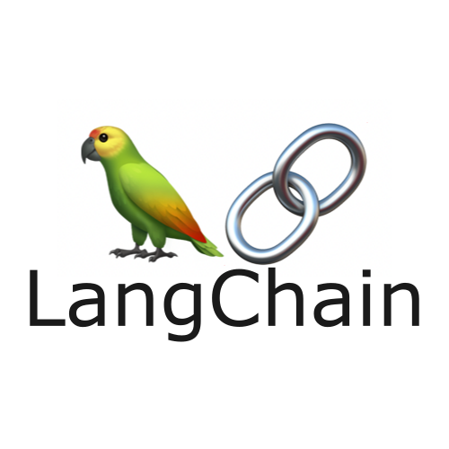
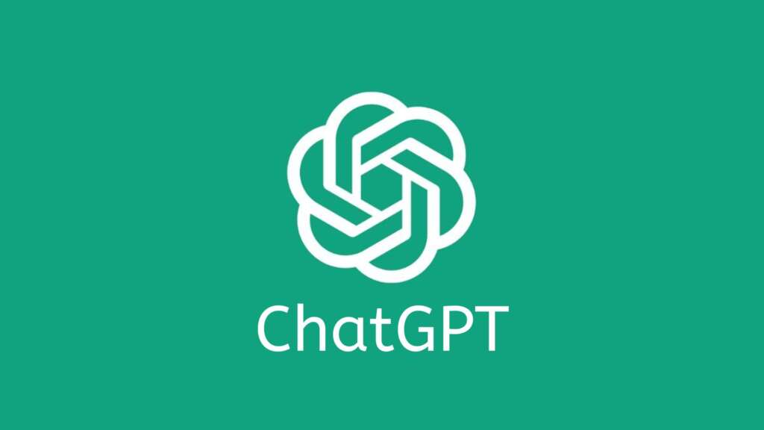



TOOLS USED
GOOGLE COLAB
LANGCHAIN
CHATGPT
GRADIO
PLAYHT
HUGGING FACE

Slide 13
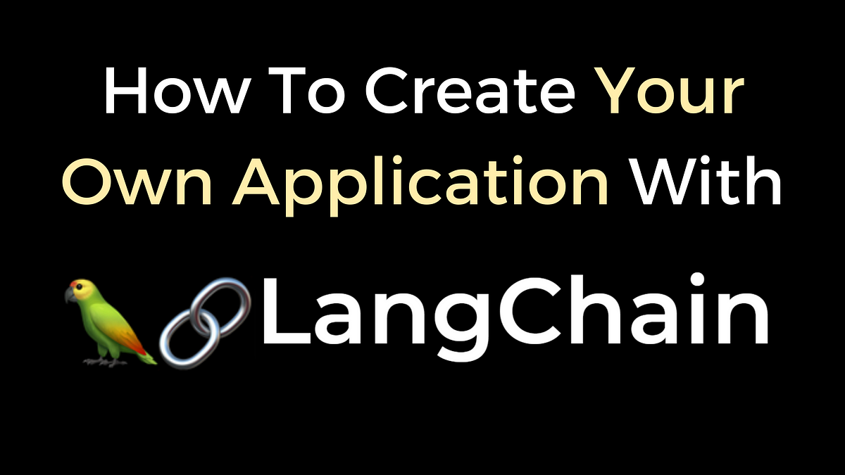
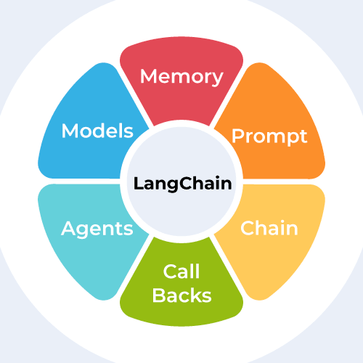
LANGCHAIN
LangChain is an intuitive open-source framework created to simplify the development of applications using large language models.
LLM is a probability distribution over words.
It allows to create apps that can take actions such as sending emails.
It allows your LLM to reference entire databases when coming up with its answers.
LangChain is a bid source data.

Slide 14

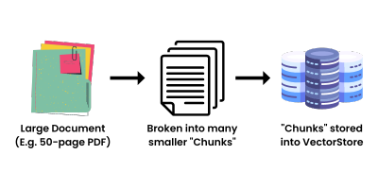

Slide 15

GOOGLE COLAB
Colab allows anybody to write and execute arbitrary python code through the browser.
Colab is a free Jupyter notebook environment that runs entirely in the cloud.
This is well suited to machine learning, data analysis and education.
It allows you to use and share Jupyter notebooks with others without having to download, install or run anything.
Colab notebooks are stored in Google Drive, or can be loaded from GitHub.

Slide 16
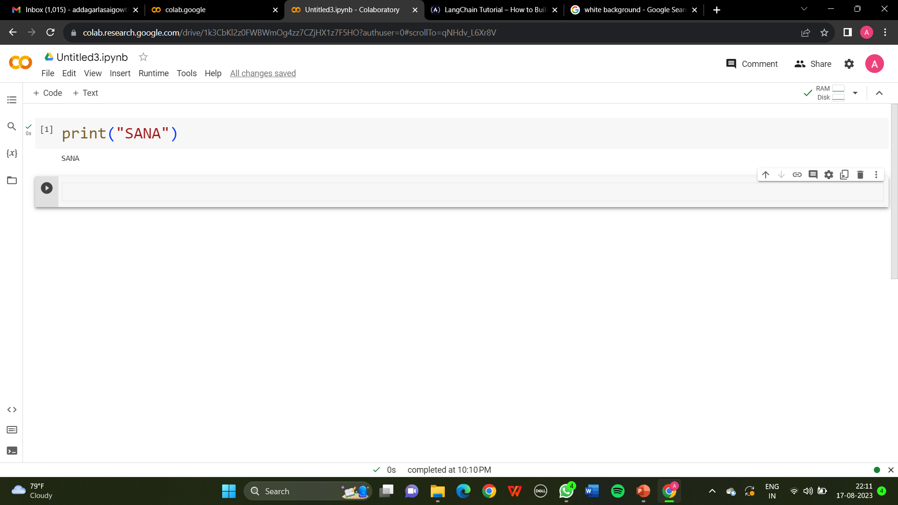

Slide 17

PLAYHT
PlayHT is an advanced platform that offers AI voice cloning services.
Transforms ultrarealistic voices and can convert the written content to audible speech.
We can handpick the preferred auditory tone.
Applications-Voice Auditioning and elevating E-learning.
PlayHT makes it easy to clone a voice and then output the voice to whatever text we want.

Slide 18
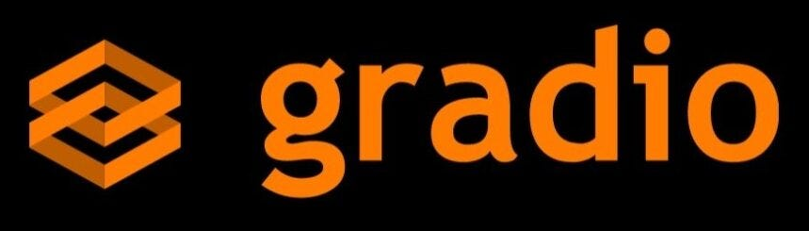
GRADIO
Gradio is a Python library.
Easy way to create interactive user interface for ML models.
For using the Gradio we need to
Import Gradio
Embed Gradio app
Run the app
It is a versatile library with advanced customizations.
Used to create complex interfaces involving images, audios.

Slide 19

HUGGING FACE
Hugging Face gives the ability to create your own AI models.
It lets you create discussions directly on the model page, which is handy for collaborating with others.
Once it's ready to use, you can run it directly from Hugging Face.
Out of the over 200,000 models available.
Allows to work with things like Natural language processing, Audio and Multimodal Models
You can also download models, train them with your own data, or quickly create a Space

Slide 20
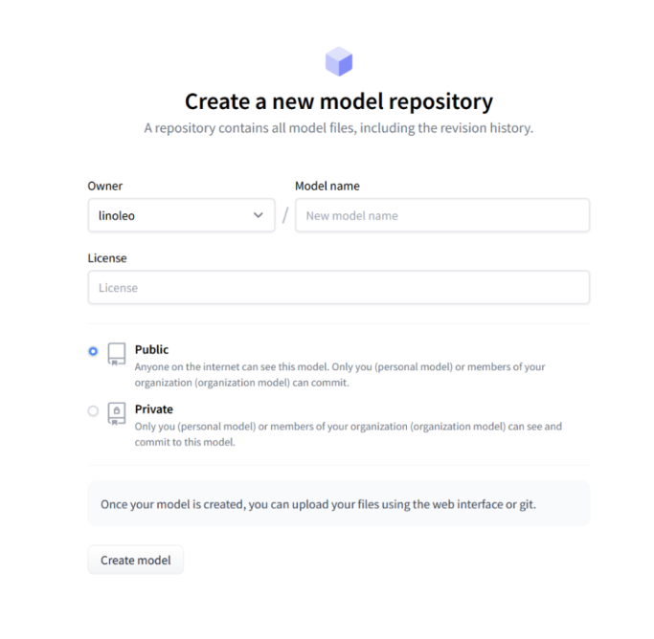

Slide 21

CHATGPT
ChatGPT is an AI chatbot that uses natural language processing to create humanlike conversational dialogue.
The objective is to improve customer service by providing fast and accurate responses to customer inquiries
It is based on the transformer architecture, which is trained on a large corpus of text data.
Can generate human-like text content.
You can write stories, poems, generate music chords, debug and write code, get easy explanations

Slide 22
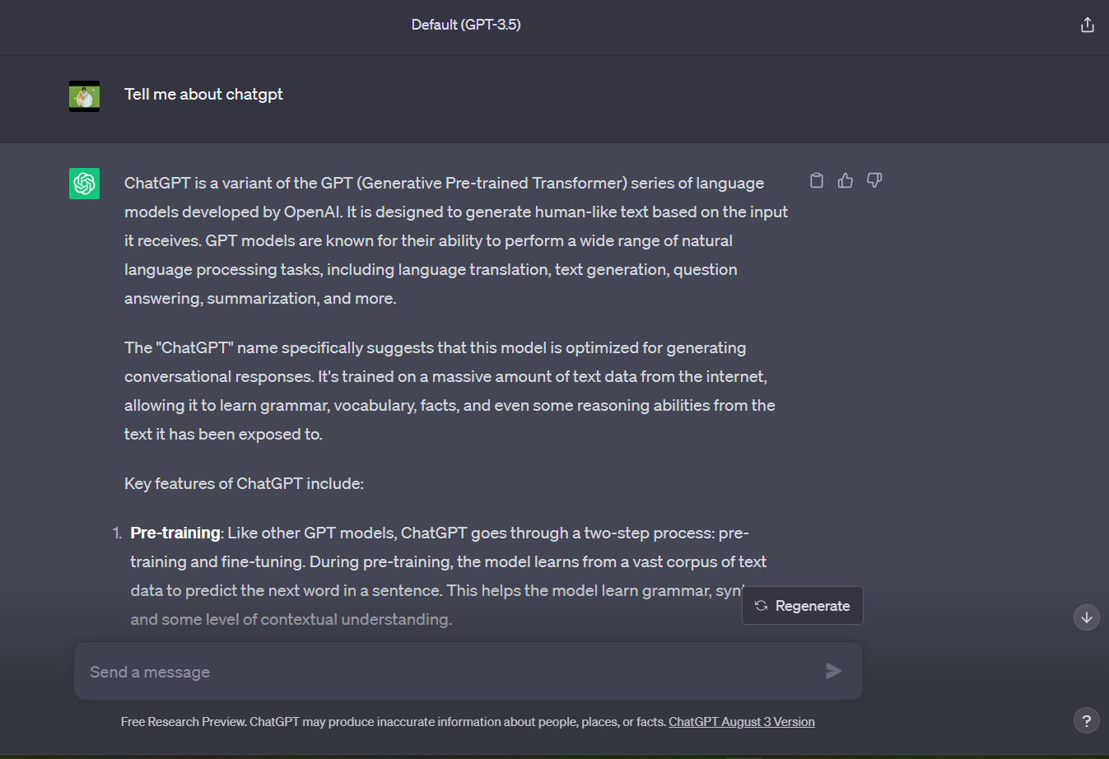

Slide 23
BACKGROUND
We have used all the tools – ChatGPT, GoogleColab, LangChain, Gradio, PlayHT and HuggingFace to build the chatbot.
GoogleColab – to write the complete code and execute for making the chatbot.
ChatGPT – Provides the access to AI language model and helps to generate the answers by integrating NLP, text generation and more.
PlayHT – This is the platform we used to clone the voice, it uses deep learning model to train a voice clone.
Langchain – Provided an interface to combine the Large Language Models and build the chatbot.
Hugging face – We have used this to train and deploy the cutting edge of ML model i.e., SANA.
Gradio – It helped us creating an interactive interface for our chatbot without any extensive coding knowledge.

Slide 24
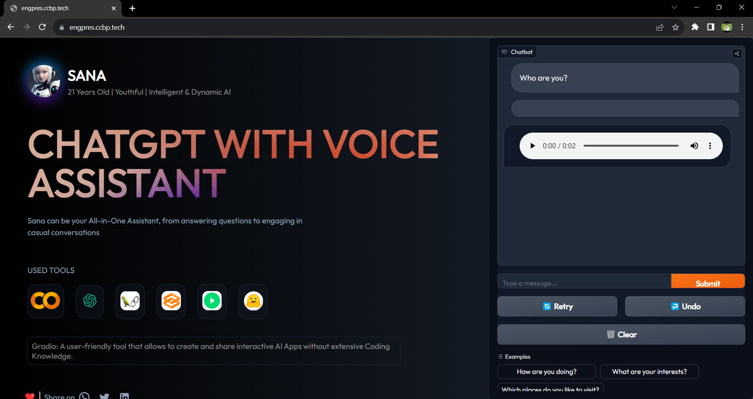

Slide 25

THE CODE
FRONT END
BACK END

Slide 26
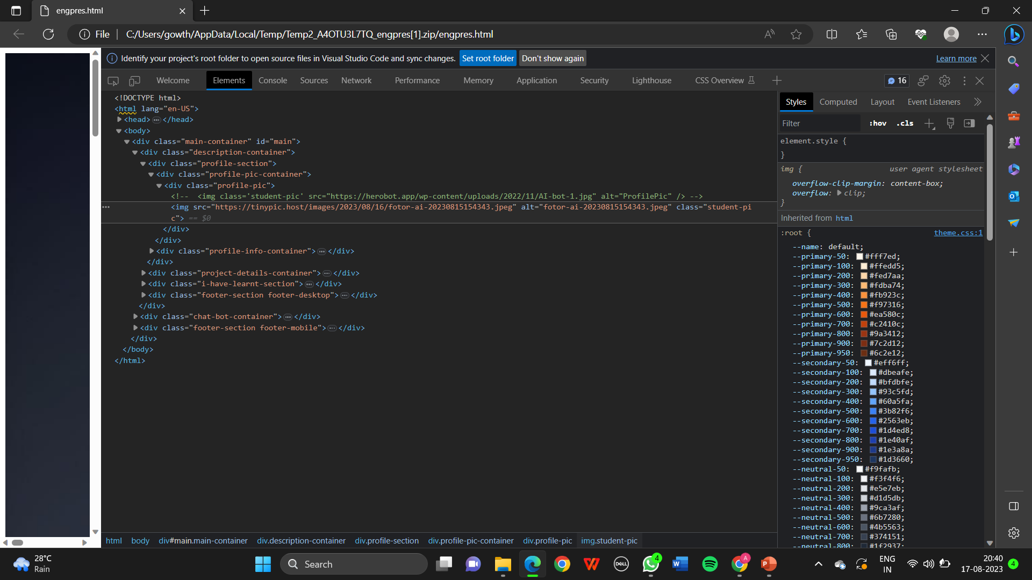
FRONT END
HTML

Slide 27
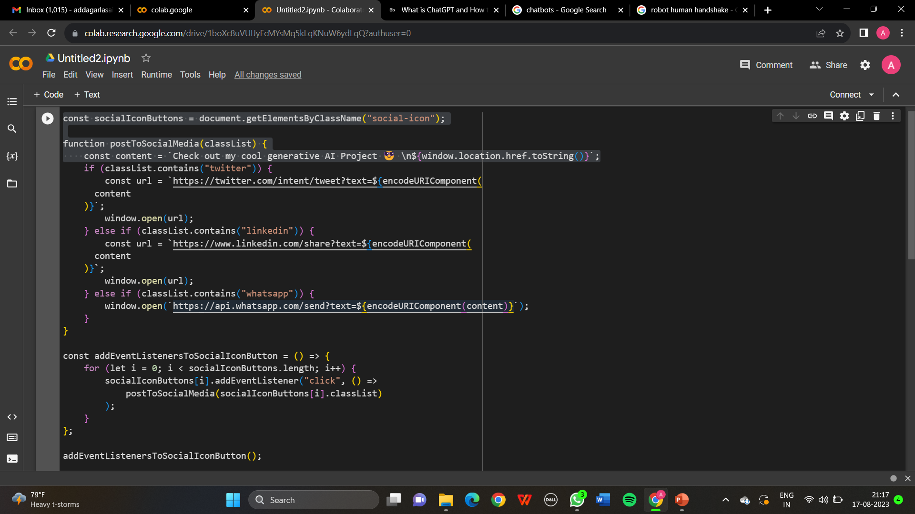
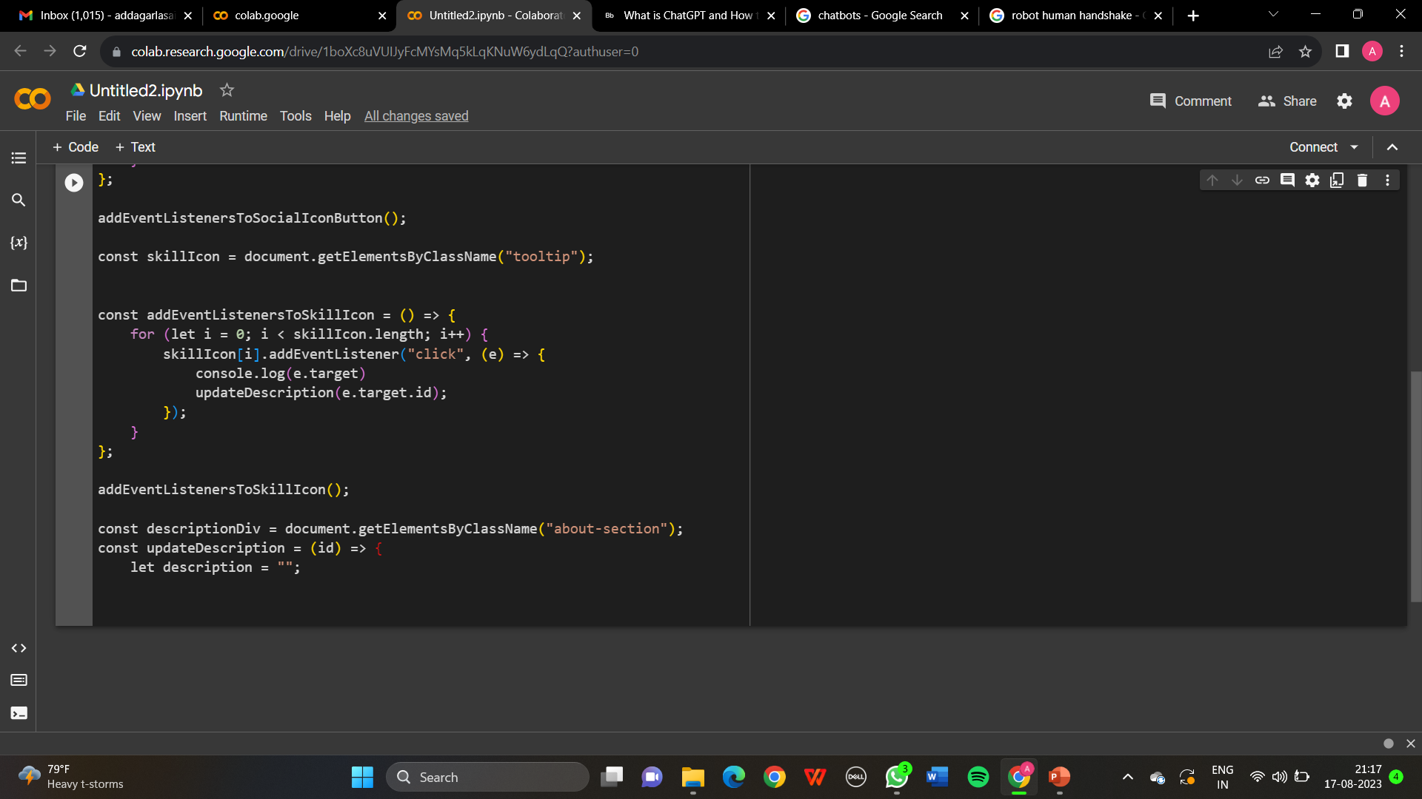
FRONT END
JAVASCRIPT

Slide 28
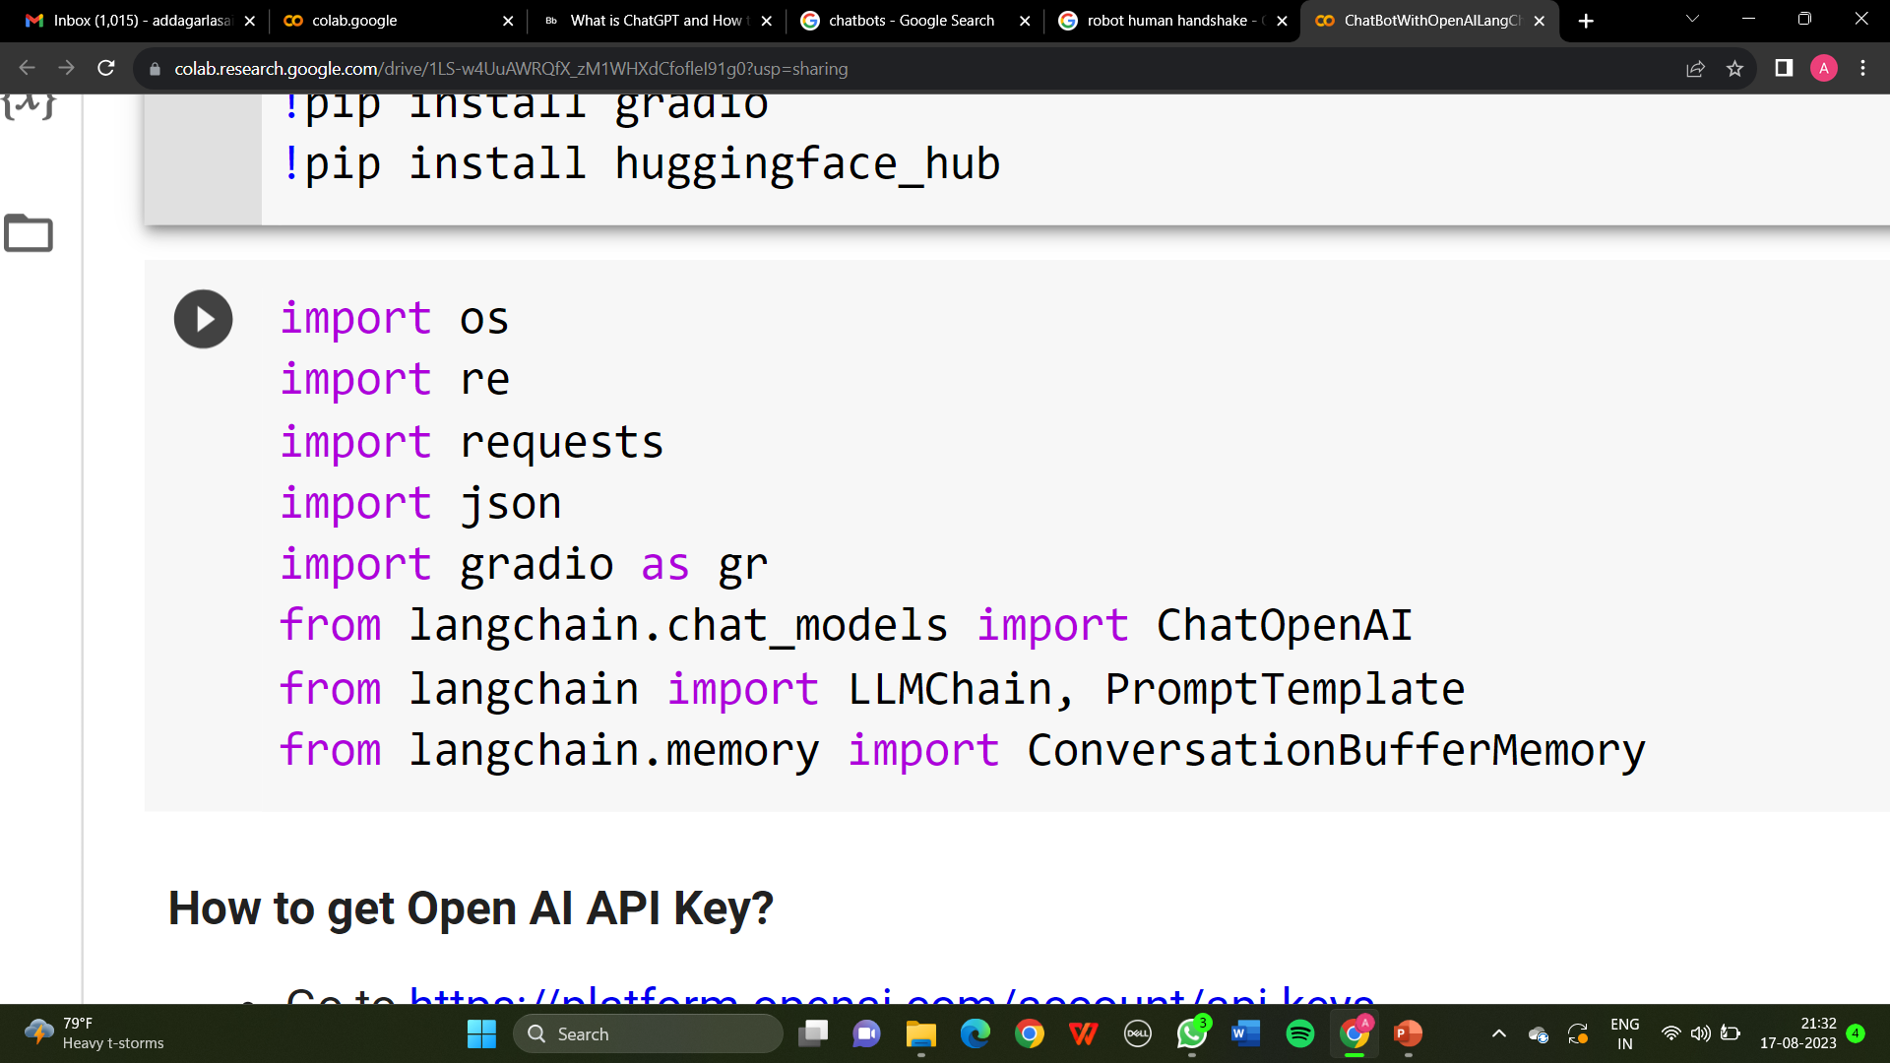
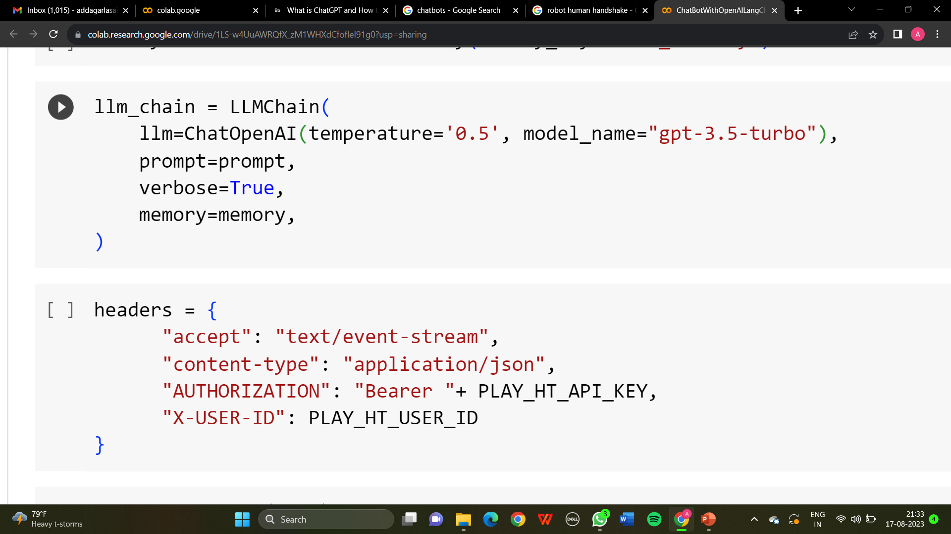
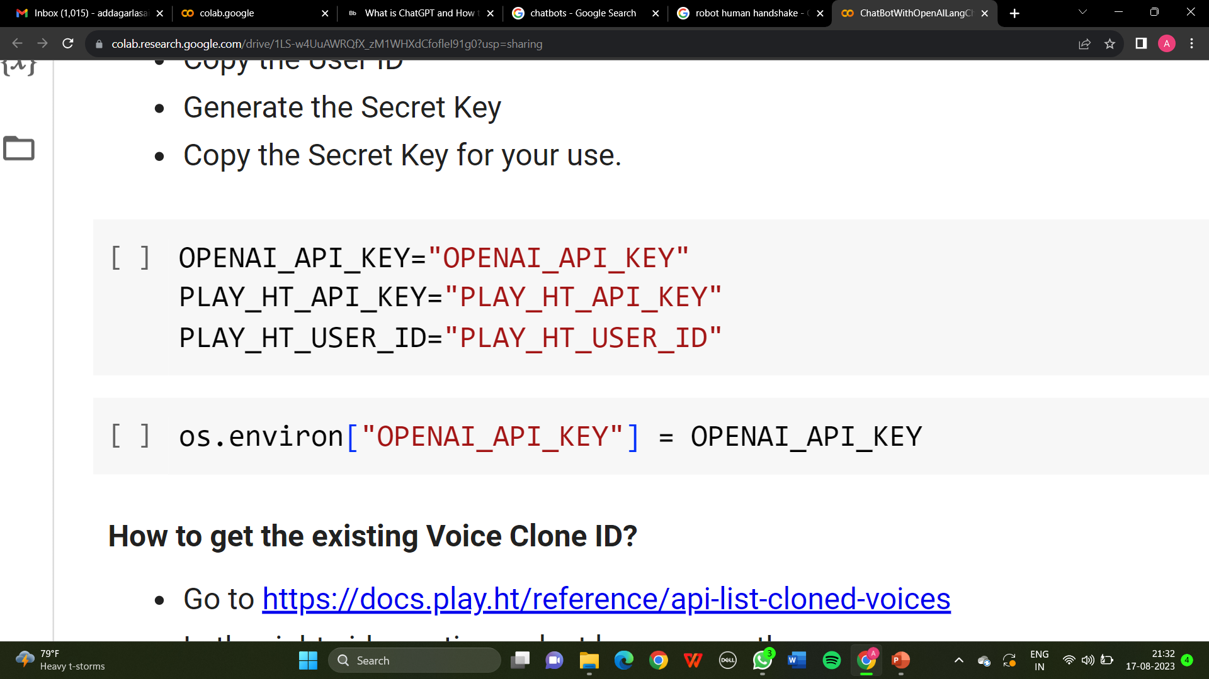
BACK END

Slide 29
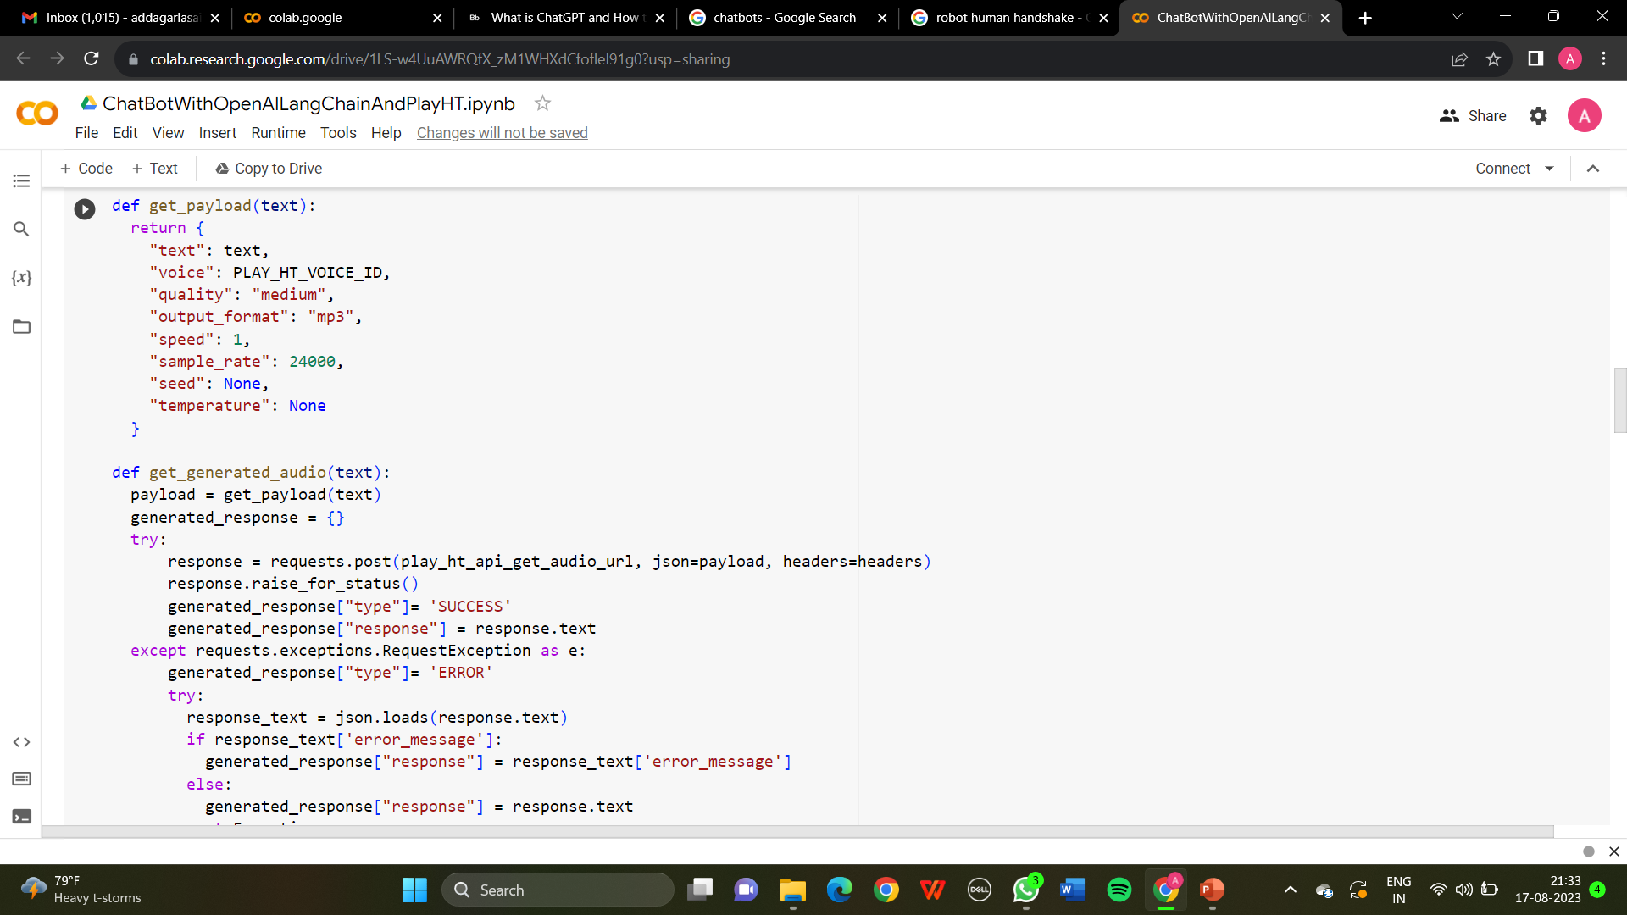
BACK END

Slide 30
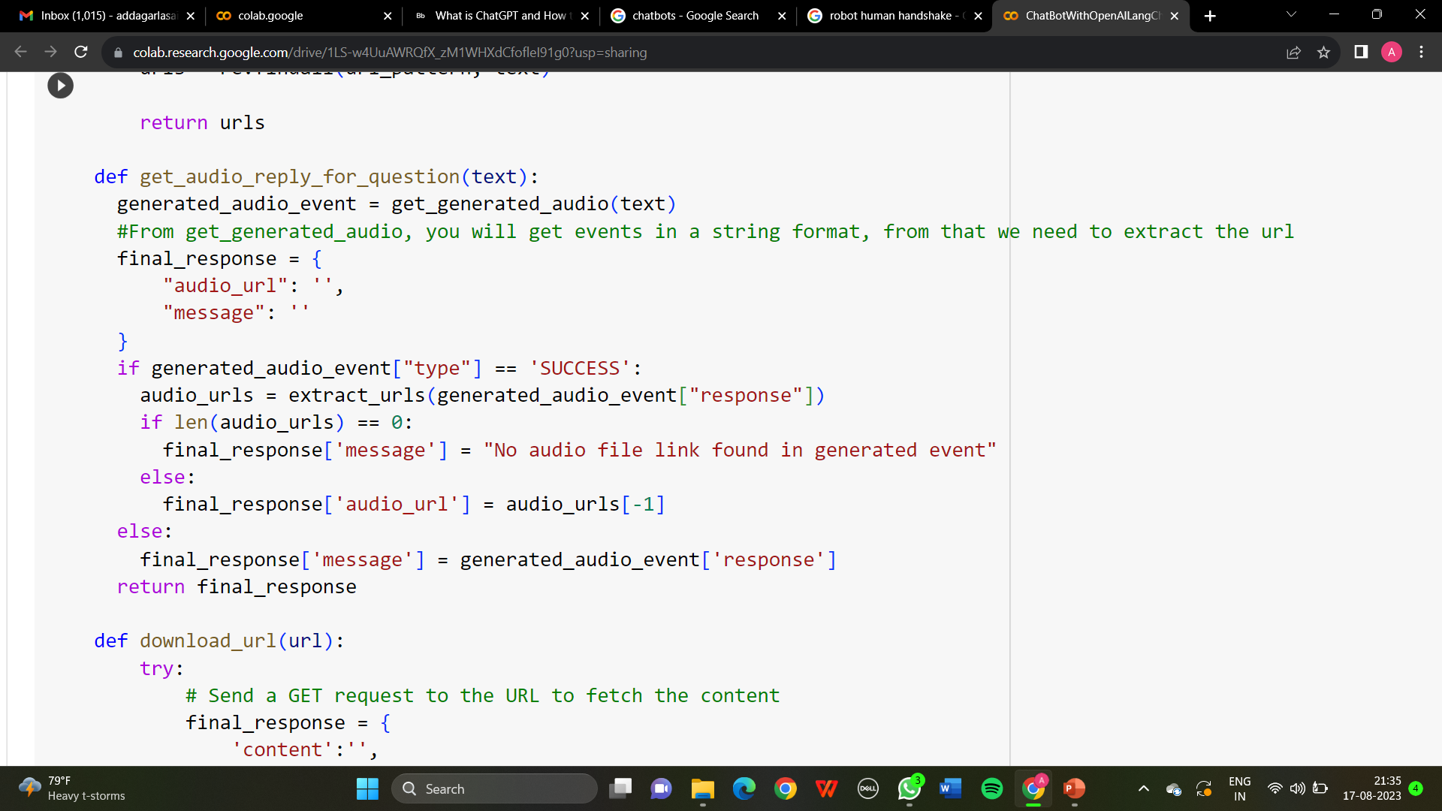
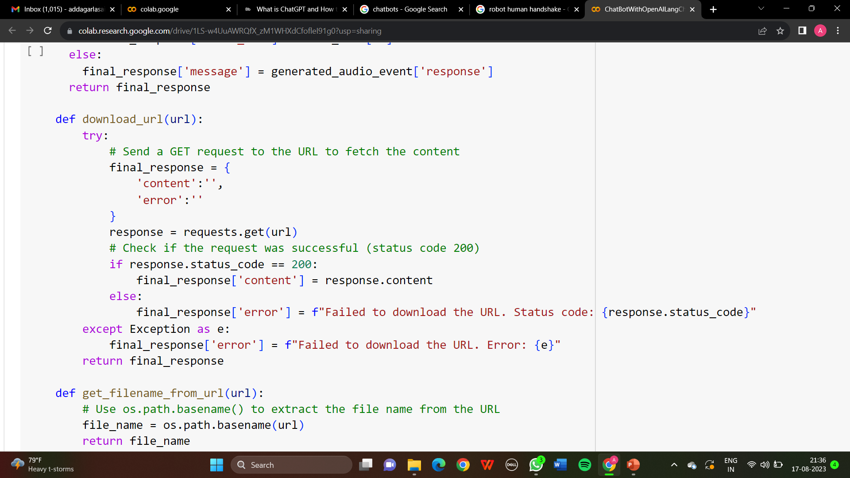
BACK END

Slide 31
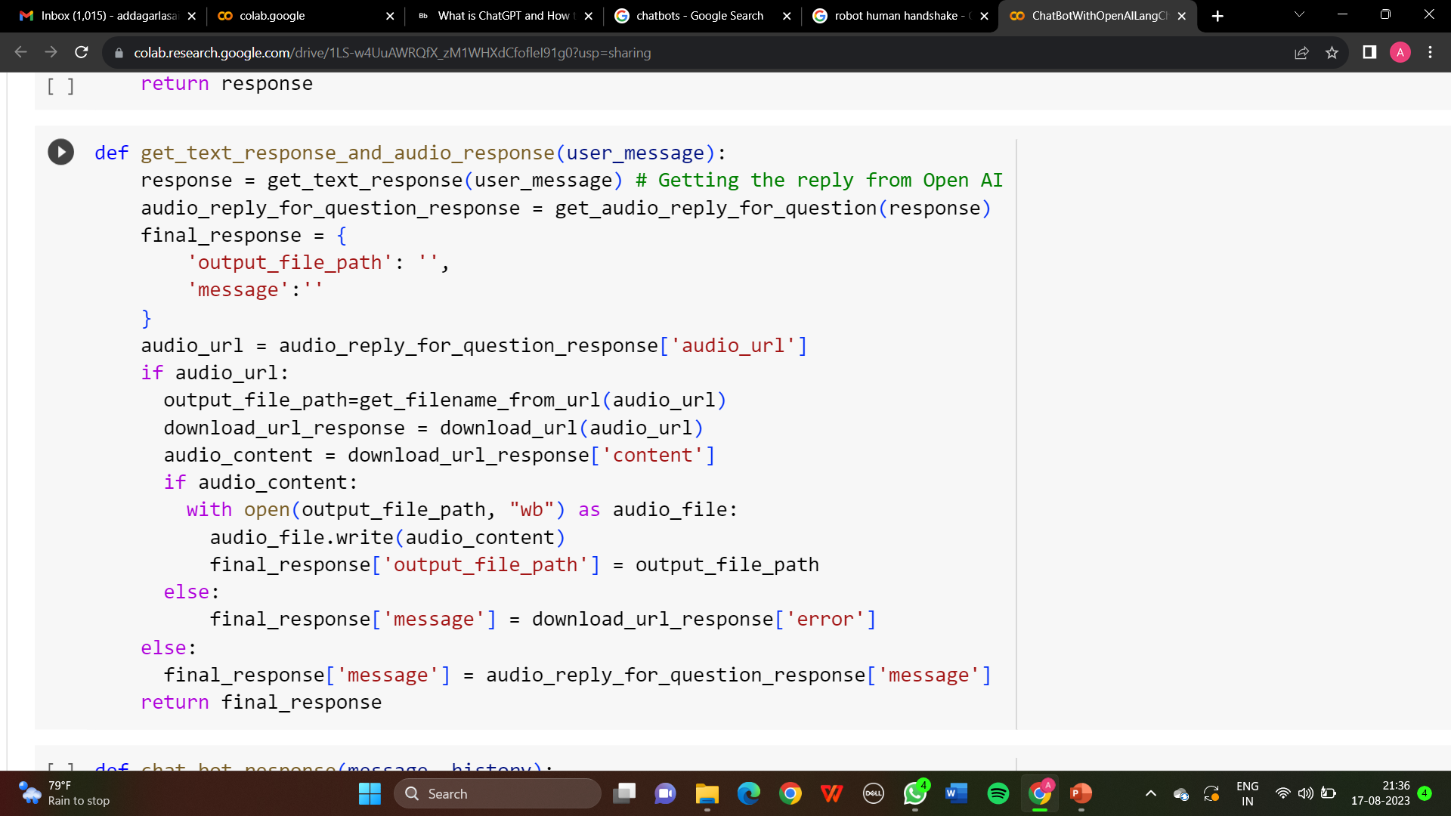
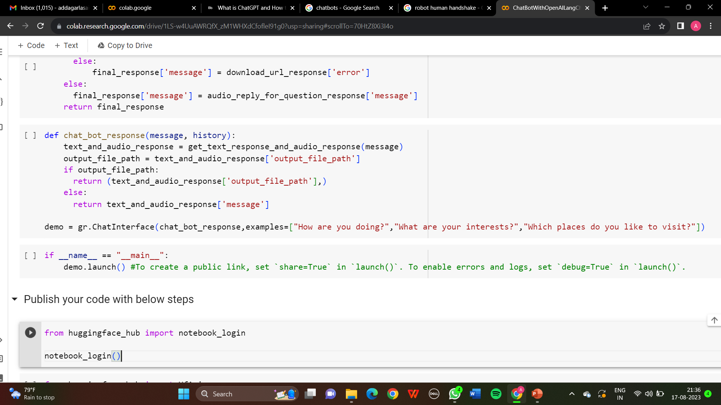
BACK END

Slide 32
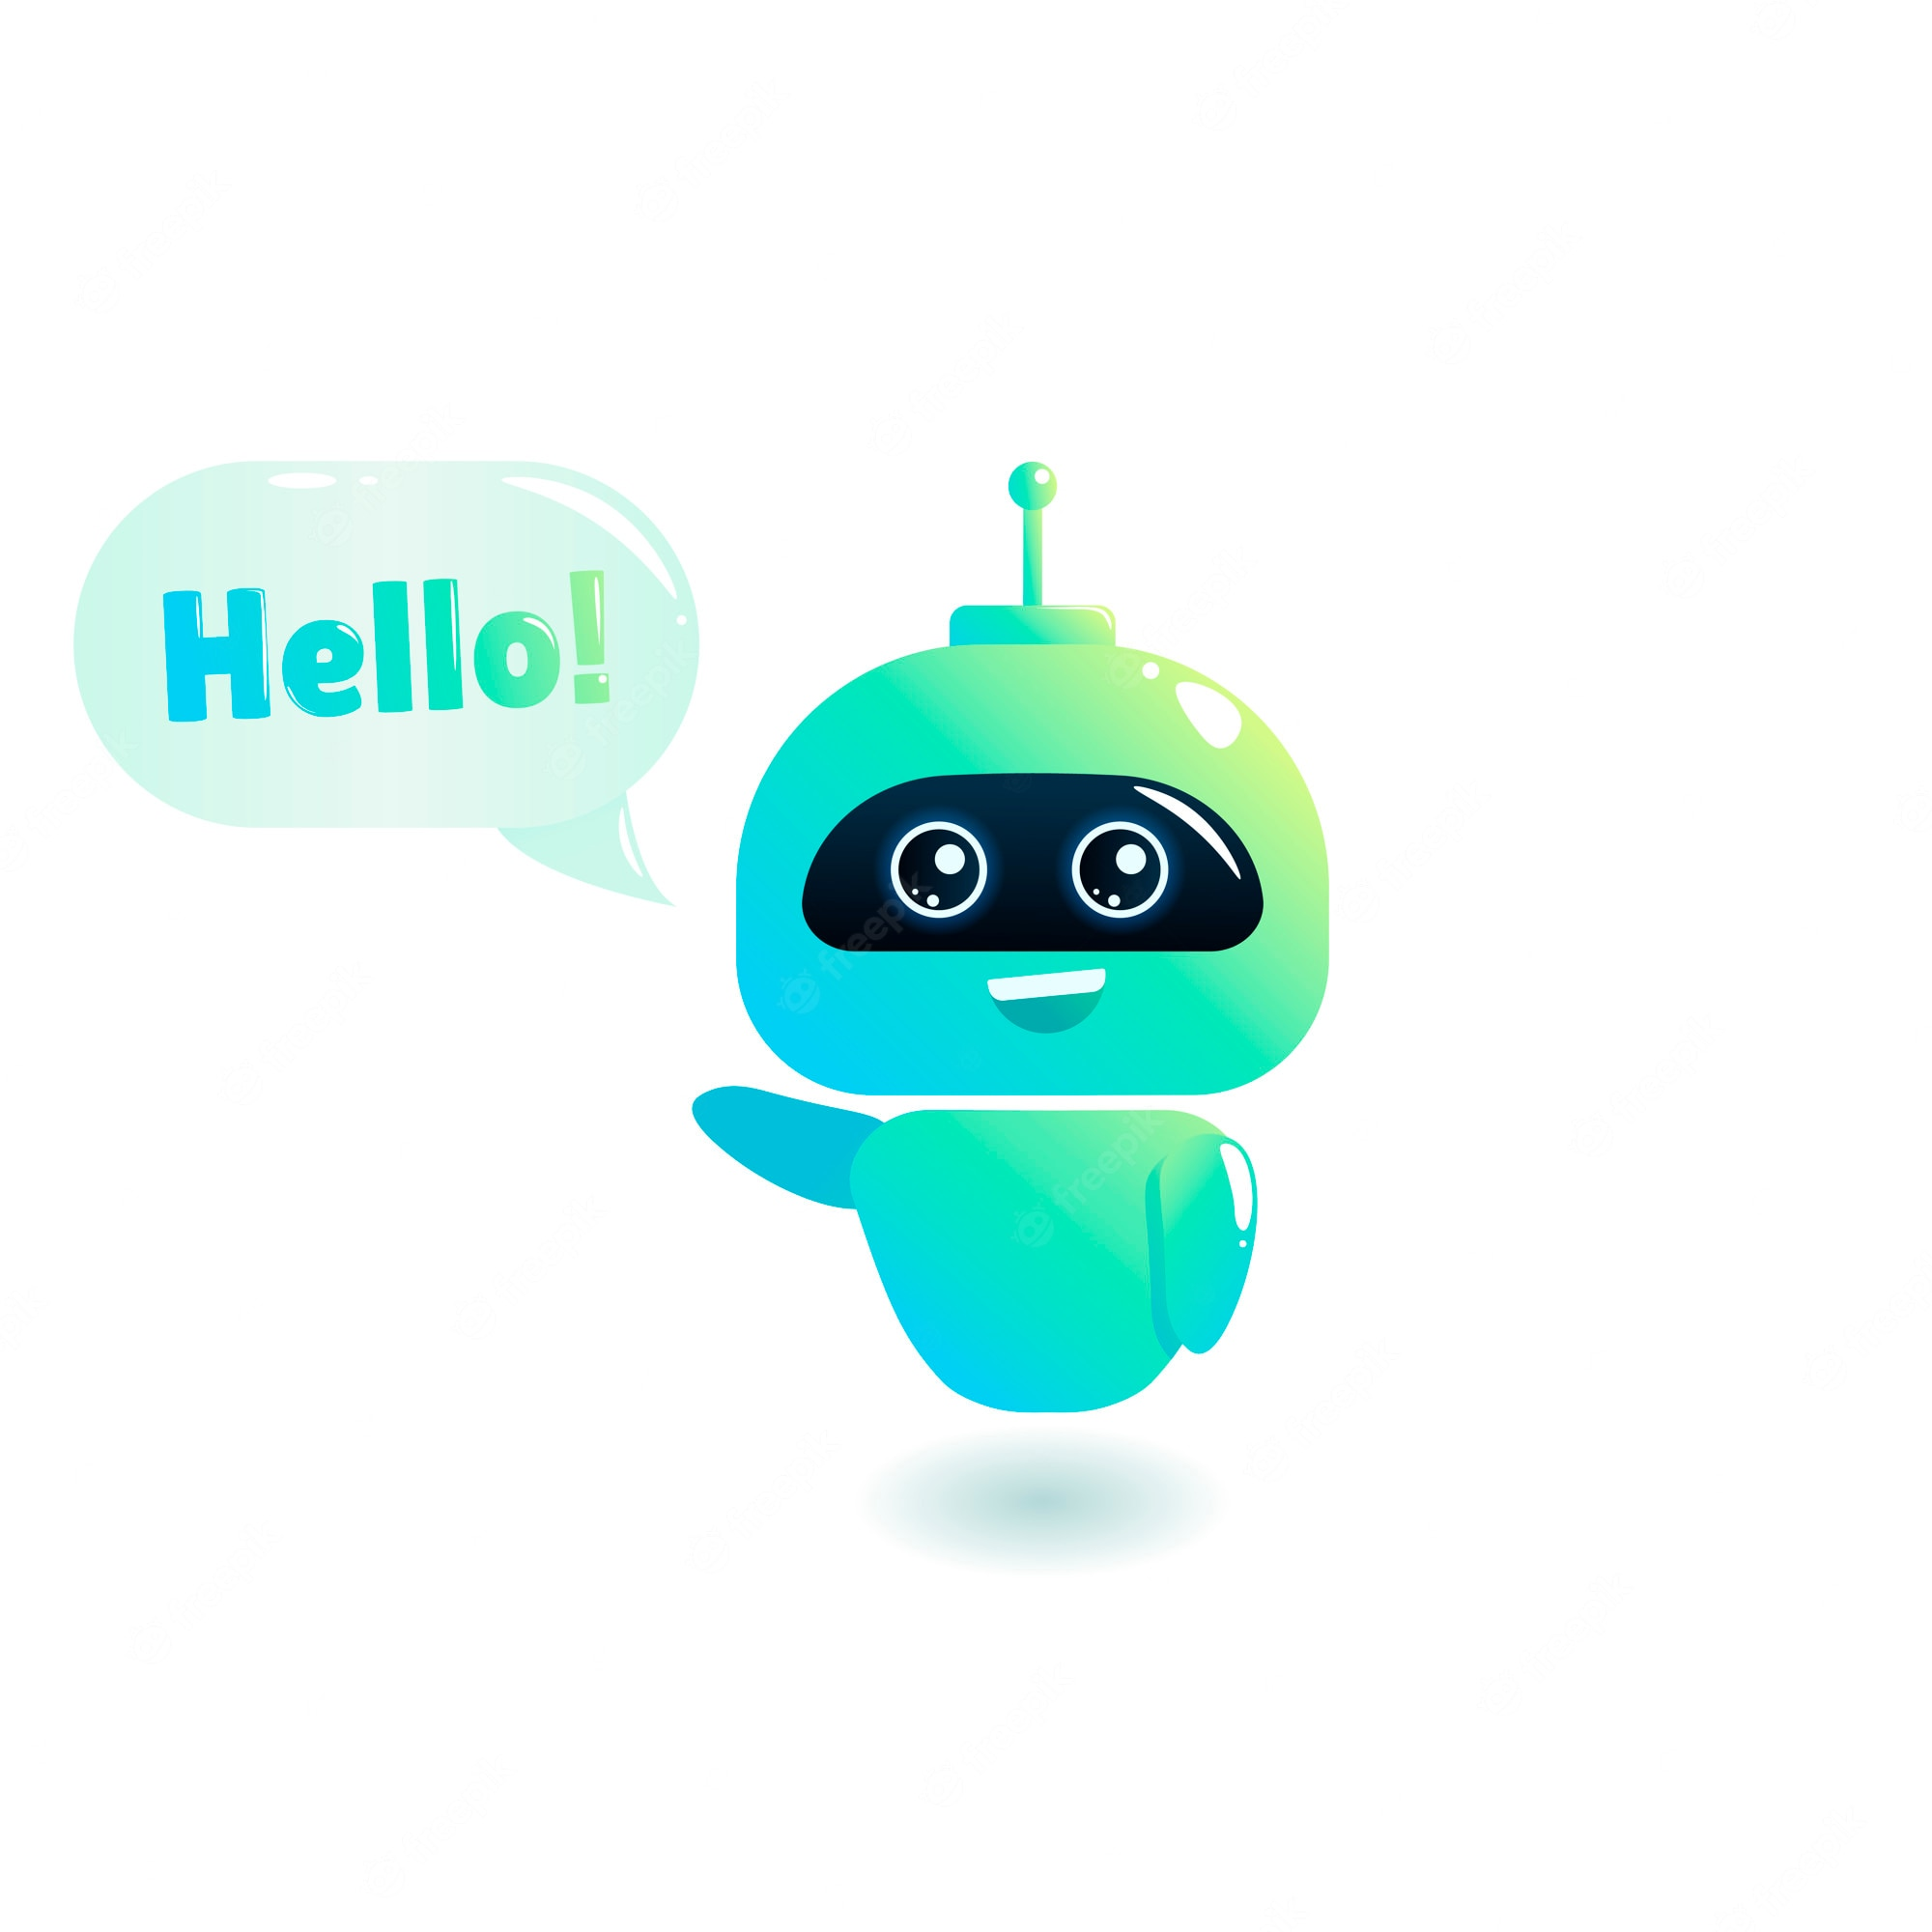

WORKING OF THE CHATBOT
https://engpres.ccbp.tech/

Slide 33
VOICE SYNTHESIS
MULTILANGUAGE SUPPORT
NATURAL LANGUAGE PROCESSING
FEATURES
CONTEXTUAL UNDERSTANDING
FEEDBACK AND IMPROVEMENT
ANSWERING QUESTIONS

Slide 34

PROS AND CONS

Slide 35
PROS AND CONS
PROS:
It enhances the accessibility of chatbot to visually challenged people.
It gives us 80% accuracy in the output.
Allows us to adjust the play back speed of the voice output if required.
People can access this chatbot if there is an issue with ChatGPT.
Low Cost

Slide 36
PROS AND CONS
CONS:
The input and output is limited to 2000 letters.
Time Delay.
No moral or ethical considerations.
Data is updated only up to 2021.

Slide 37
CONCLUSION
Through its innovative voice interface SANA bridges the gap between technology and accessibility, offering a lifeline of support for daily tasks.
SANA not only showcases the potential of AI driven solutions but also paves the way for a more accessible and equitable future.
SANA remains a shining example of how innovation can truly make a difference in lives of those who need it the most

Slide 38
THANK YOU!

